Slide 1
People and Communities three years in
Jill Baker
23 November 2023
Join the discussion online #LocalChange

Slide 2
Why are we doing this?

Slide 3
We’re facing multiple crises
More than 10 years of austerity
Brexit and the impact from it
Covid and national lockdowns
Escalating cost of living
Social security reform
World events
Cost of living
Covid
Social security reform
World events
Brexit
Austerity

Slide 4
Under pressure and underfunded
Demand for services is going up
Issues people face are getting more complex
Yet, there is less money in the public sector
Essential services best provided at community level
Community led organisations lack income diversification
Commissioning favours larger organisations
Demand for services
Challenges for small charities

Slide 5
Drivers
People get the support they need, when they need it, and that works best for them
Increased demand and complexity
Reducing budgets

Slide 6
Money comes and money goes…
Community Development Projects (1970s) / Inner City Challenge (1980s) / Single Regeneration Budget (1995) / New Deal for Communities (1998) / Communities First (2001) / City Challenge (2008) / Total Place (2010) / Community and Neighbourhood budgets (2011) / Troubled Families (2012) / Better Care Fund (2013) / Our Place (2013) / ESF Objective 1 (2014) / Towns Fund (2019) / Community Ownership Fund (2021) / Levelling Up (2021) / Community Renewal Fund / The Levelling up Fund / The Levelling up Fund 2 / UK Shared Prosperity Fund / Know your Neighbourhood Fund (2023)…
Short term
Short lived
Siloed
Small scale

Slide 7
We need something different
A new way to
design
deliver
resource
…services for people facing complex challenges in their lives.
Notes:
This is the copy from another slide you had that I think would be best spoken:
We need to develop new models of service design, delivery and resourcing which are sustainable…
- this will require a shift in thinking away from thinking of ourselves as public/private/voluntary/academic - to a collective paradigm which works across organisations and structures and involves everyone (including people who use services)
“We need to shift the systems that are holding the problem in place”
(Social Innovation Generation)

Slide 8
Why are we doing this?

Slide 9
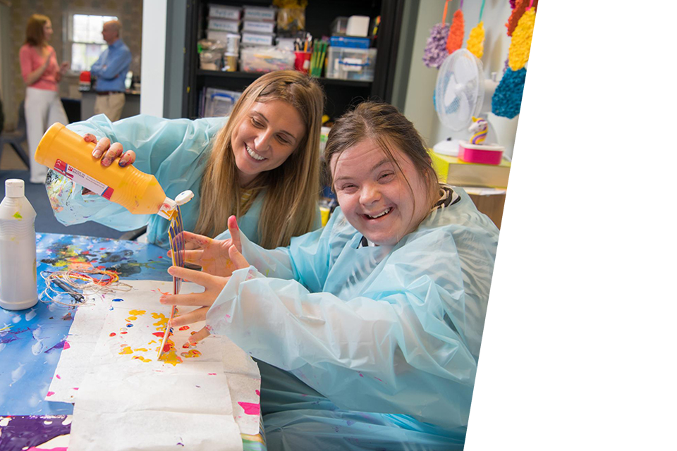
Our vision
is of a just and compassionate society where people facing complex issues and barriers have the opportunity to thrive.
Our mission
is to partner with small and local charities, people and communities working towards a more just and compassionate society.
Gateway Into The Community, a charity we partner with in the North East

Slide 10
Why small?
A distinctive offer, approach and position
What
How
Where
What they do
How they do it
Where they do it
First responders
Safe spaces
Promote inclusion
Person-centred
Embedded, trusted
Reaching early, staying longer
Open door
Quick decision making
Diversity
Local networks & relationships
The ‘glue’
Advocacy

Slide 11
More than the sum of their parts
Economic value
Individual value
Added value
Value to the economy
Economic value of outcomes, including to public services
Meeting basic and unmet needs
'Soft' personal, social and emotional outcomes
'Hard' more tangible outcomes
The cross-cutting value of volunteering
Funding sources and leverage
Embeddedness in local organisational and social networks

Slide 12
Why are we doing this?

Slide 13
What is this?
To explore and facilitate new ways of designing and resourcing local services with the aim of:
1
2
3
strengthening small community-based organisations…
so people facing complex issues get the support they need…
when they need it and in ways that work best for them.

Slide 14
Situated engagement
A new way of working
System change
Social engagement
Sustained engagement

Slide 15
Social engagement
Social engagement
Build a relationship with you and your partners
Needs to be face-to-face: tacit and explicit knowledge
Involve service users and deliverers

Slide 16
Situated engagement
Situated engagement
Get to know you and your reality
What is your context? Understand it and that of your partners – and you of each other
Recognise the context may change – and that we need to work with that

Slide 17
Sustained engagement
Sustained engagement
Don’t forget the small stuff – the quick wins for you
Stick with it – and you – for the long term (2020–2029)
Build trust and allow for reflection and to respond to issues as they arise

Slide 18
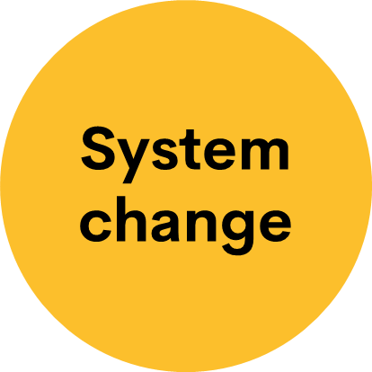
System change
Think holistically
Think behaviours
Think everyone!

Slide 19
A system isn’t the actions of any one part, project or organisation – it’s how they all behave
Julian Corner, CEO Lankelly Chase

Slide 20
Example
Cafe

Slide 21
Thank you
Join the discussion online
#LocalChange

Slide 22
Break
see you back in 10 minutes at 15.10
Join the discussion online
#LocalChange

Slide 23
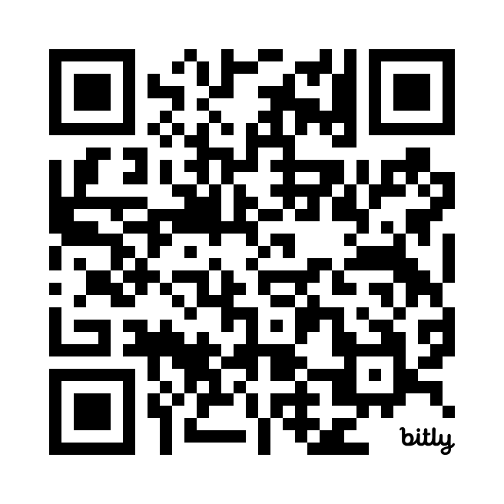
Thank you
Sign up for our monthly newsletter
https://bit.ly/LBFsubscribe
Join the discussion online #LocalChange

